Slide 1

INT219 FRONT END WEB DEVELOPER
Lecture #0
The kick start session

Slide 2
Course details
LTP – 2 0 2
Credit – 3

Slide 3
Assessment/Evaluation Scheme
Attendance: 5
CA: 45
ETP: 50

Slide 4
Complete evaluation criteria for the course
CA1: 30 marks- Test Code Based
CA2: 30 marks- BYOD
CA3: 30 marks- Project

Slide 5
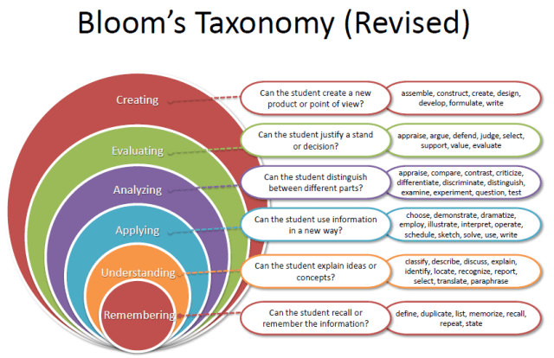
Revised Bloom’s Taxonomy

Slide 6
Course outcome
Through this course students should be able to:
CO1 : apply basic HTML elements, CSS properties and Bootstrap to create visually appealing web pages.
CO2 : use JavaScript variables, functions, and events to enhance user interactivity on web pages.
CO3 : develop interactive web forms and validate user input to enhance form handling.
CO4 : manipulate HTML elements, handle events, and create dynamic web content using JavaScript and DOM.
CO5 : employ jQuery for efficient element manipulation and work with JSON objects for seamless data exchange.
CO6 : develop dynamic web applications using Angular, and HTTP requests with forms, components, and directives.

Slide 7
Program Outcomes
PO1 Engineering knowledge: Apply the knowledge of mathematics, science, engineering fundamentals, and an engineering specialization to the solution of complex engineering problems.
PO2 Problem analysis::Identify, formulate, research literature, and analyze complex engineering problems reaching substantiated conclusions using first principles of mathematics, natural sciences, and engineering sciences.
PO3 Design/development of solutions::Design solutions for complex engineering problems and design system components or processes that meet the specified needs with appropriate consideration for the public health and safety, and the cultural, societal, and environmental considerations.
PO4 Conduct investigations of complex problems::Use research-based knowledge and research methods including design of experiments, analysis and interpretation of data, and synthesis of the information to provide valid conclusions.

Slide 8
Program Outcomes
PO5 Modern tool usage::Create, select, and apply appropriate techniques, resources, and modern engineering and IT tools including prediction and modeling to complex engineering activities with an understanding of the limitations.
PO6 The engineer and society::Apply reasoning informed by the contextual knowledge to assess societal, health, safety, legal and cultural issues and the consequent responsibilities relevant to the professional engineering practice.
PO7 Environment and sustainability::Understand the impact of the professional engineering solutions in societal and environmental contexts, and demonstrate the knowledge of, and need for sustainable development.
PO8 Ethics::Apply ethical principles and commit to professional ethics and responsibilities and norms of the engineering practice.
PO9 Individual and team work::Function effectively as an individual, and as a member or leader in diverse teams, and in multidisciplinary settings.

Slide 9
Program Outcomes
PO10 Communication::Communicate effectively on complex engineering activities with the engineering community and with society at large, such as, being able to comprehend and write effective reports and design documentation, make effective presentations, and give and receive clear instructions.
PO11 Project management and finance::Demonstrate knowledge and understanding of the engineering, management principles and apply the same to one’s own work, as a member or a leader in a team, manage projects efficiently in respective disciplines and multidisciplinary environments after consideration of economic and financial factors.
PO12 Life-long learning::Recognize the need for, and have the preparation and ability to engage in independent and life-long learning in the broadest context of technological change.
PO13 Competitive Skills::Ability to compete in national and international technical events and building the competitive spirit alongwith having a good digital footprint.

Slide 10
Course contents
Unit I
Overview of HTML, CSS and JavaScript : Fundamentals of HTML, Creating Style Sheet, CSS Box Model- Border properties, Padding properties, Margin properties, Introduction to JavaScript, Working with Web Forms and validating user input, JavaScript functions and events, JavaScript Timing Events, JavaScript Image Slideshow, Recursive function in JavaScript, Error handling in JavaScript

Slide 11
Course contents
Unit II
Document Object Model in JavaScript : Document Object Model, Programming HTML DOM with JavaScript, Assigning event handlers in JavaScript using DOM object property, addeventlistener and removeeventlistener in JavaScript, Event bubbling in JavaScript, Image gallery with thumbnails in JavaScript

Slide 12
Course contents
Unit III
Working with jQuery and JSON : Basics of jQuery, jQuery Events, Benefits of using CDN, jQuery Selectors, jQuery input vs :input, jQuery DOM manipulation methods, jQuery Elements, Working with JSON Objects, JSON Arrays, Nested JSON object, Conversion of JSON object to string, Conversion of string to JSON object

Slide 13
Course contents
Unit IV
Working with Bootstrap : Introduction to Bootstrap, Setting up Bootstrap, Bootstrap Grid System, Bootstrap Image Gallery, Bootstrap Typography, Bootstrap Blockquotes and Lists, Bootstrap Code Blocks, Bootstrap Table Classes, Bootstrap Button Classes, Bootstrap Dropdown, Create a customized application using Bootstrap

Slide 14
Course contents
Unit V
Basics of Angular : Introduction to Angular, features, Installation, architecture, basics of TypeScript, modules, components, directives-ngIf, ngStyle, Databinding- string interpolation, event binding, property binding.

Slide 15
Course contents
Unit VI
Handling forms and HTTP requests in Angular : Forms- reactive forms, template-driven forms, using angular pipes to transform output, HTTP requests, using services and Dependency Injection

Slide 16
List of Practicals
Design web page using table and list concept in HTML.
Design web page using images, links and frames in HTML.
Design forms and perform various types of validations in HTML.
Design attractive web page using CSS and JavaScript.
Implement the concept of event handlers in JavaScript using DOM object property.
Implement event bubbling in JavaScript.
Make Image gallery with thumbnails in JavaScript.

Slide 17
List of practicals
Design web page using jQuery Selectors and elements.
Use JSON objects, arrays and string concept in your web pages.
Design interactive website using Angular modules, directives concepts.
Design interactive website using Angular filters and events concepts.
Design customizable website using Bootstrap Grid System and Typography.
Implement Bootstrap list, table, buttons and dropdowns.

Slide 18
List of practicals
Implement HTTP requests and dependency injection in Angular

Slide 19
Text & Reference Books
Text Books: HTML5 BLACK BOOK by KOGENT LEARNING SOLUTIONS INC., DREAMTECH PRESS
References: MASTERING HTML, CSS & JAVA SCRIPT WEB PUBLISHING by LAURA LE MAY, RAFE COLBURN, JENNIFER KYRNIN, BPB PUBLICATIONS

